Slide 1
Safeguarding citizens privacy and ownership of their personal data
How might we build telemetry and data insights without compromising citizen privacy?
Building Citizen’s Trust in this Digital World
In order to access online services, citizens need to give their consent for their data to be used. How do you gain their trust that their data will be used appropriately?

Slide 2
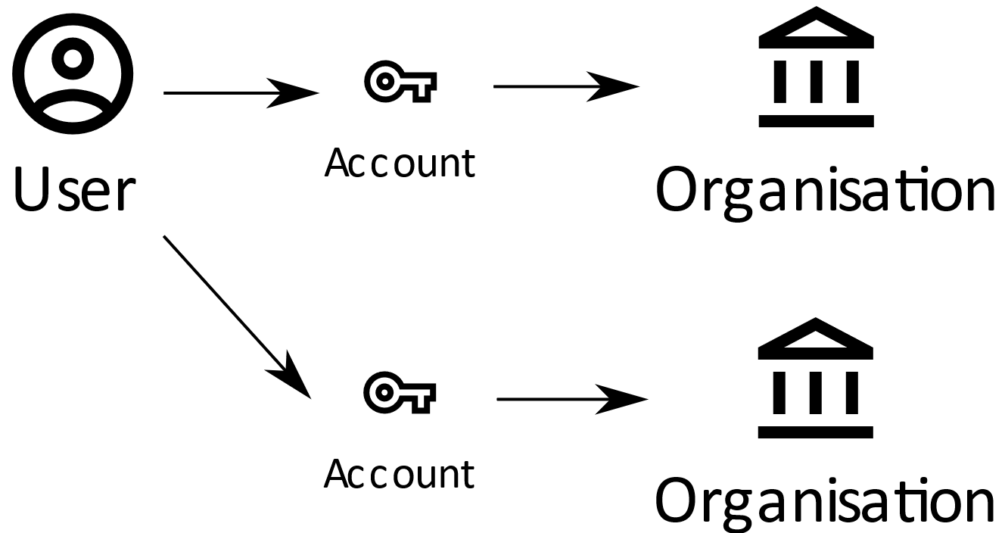
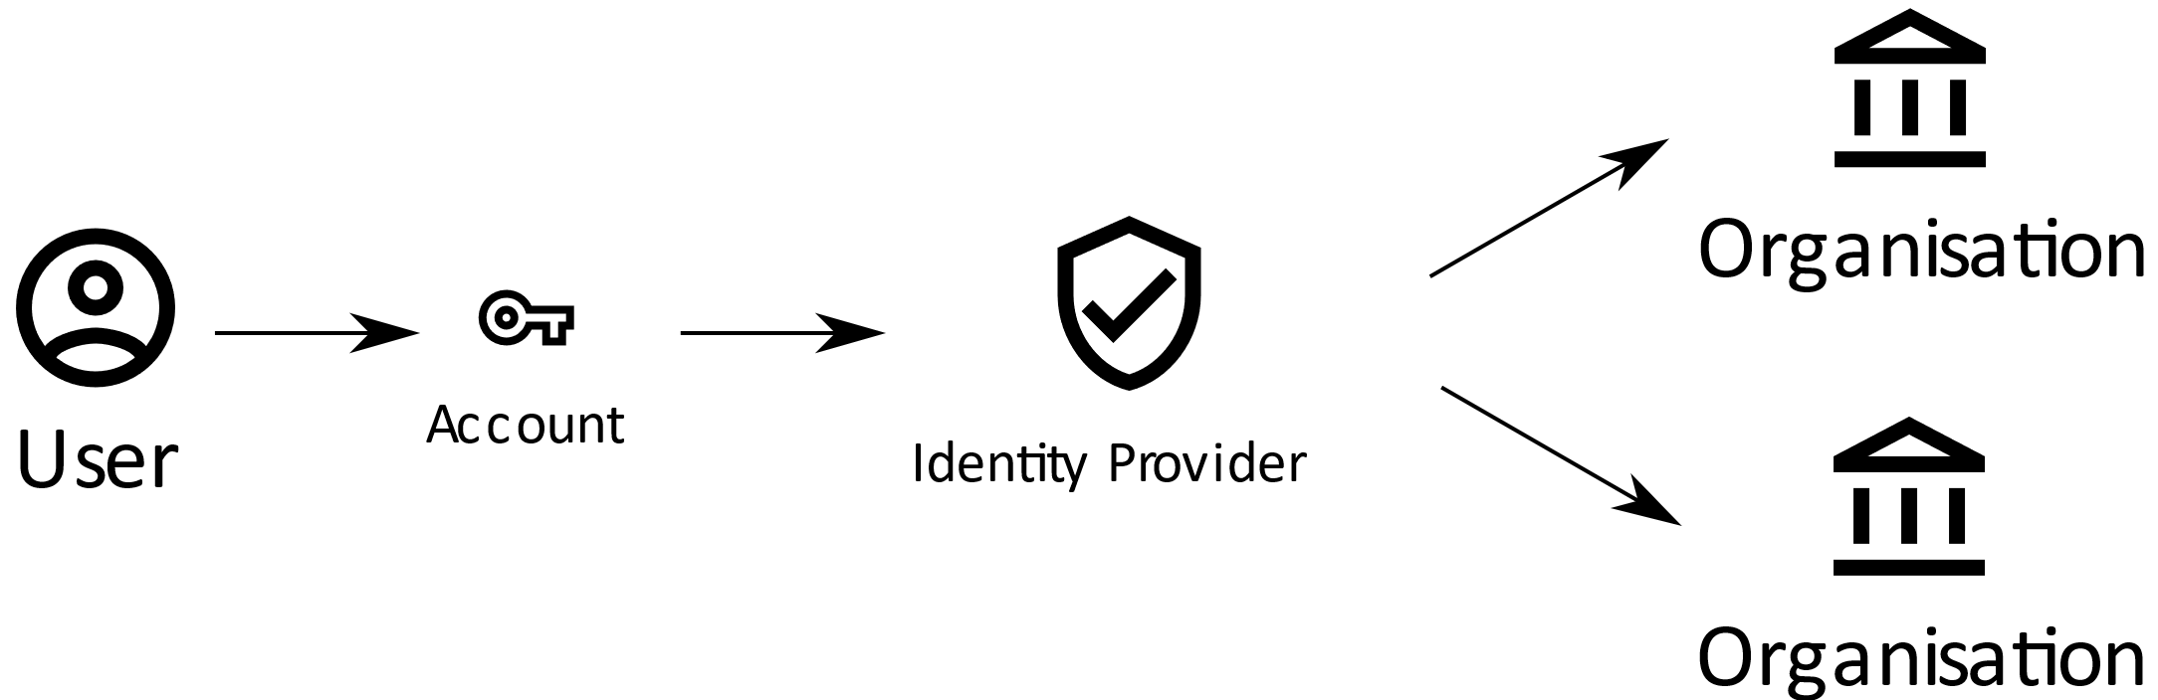
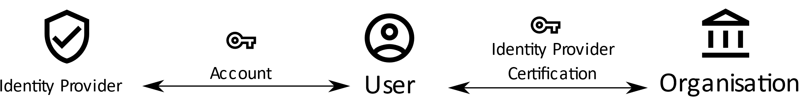
Traditional Identity Examples
Siloed:
Federated:
User Centric:

Slide 3
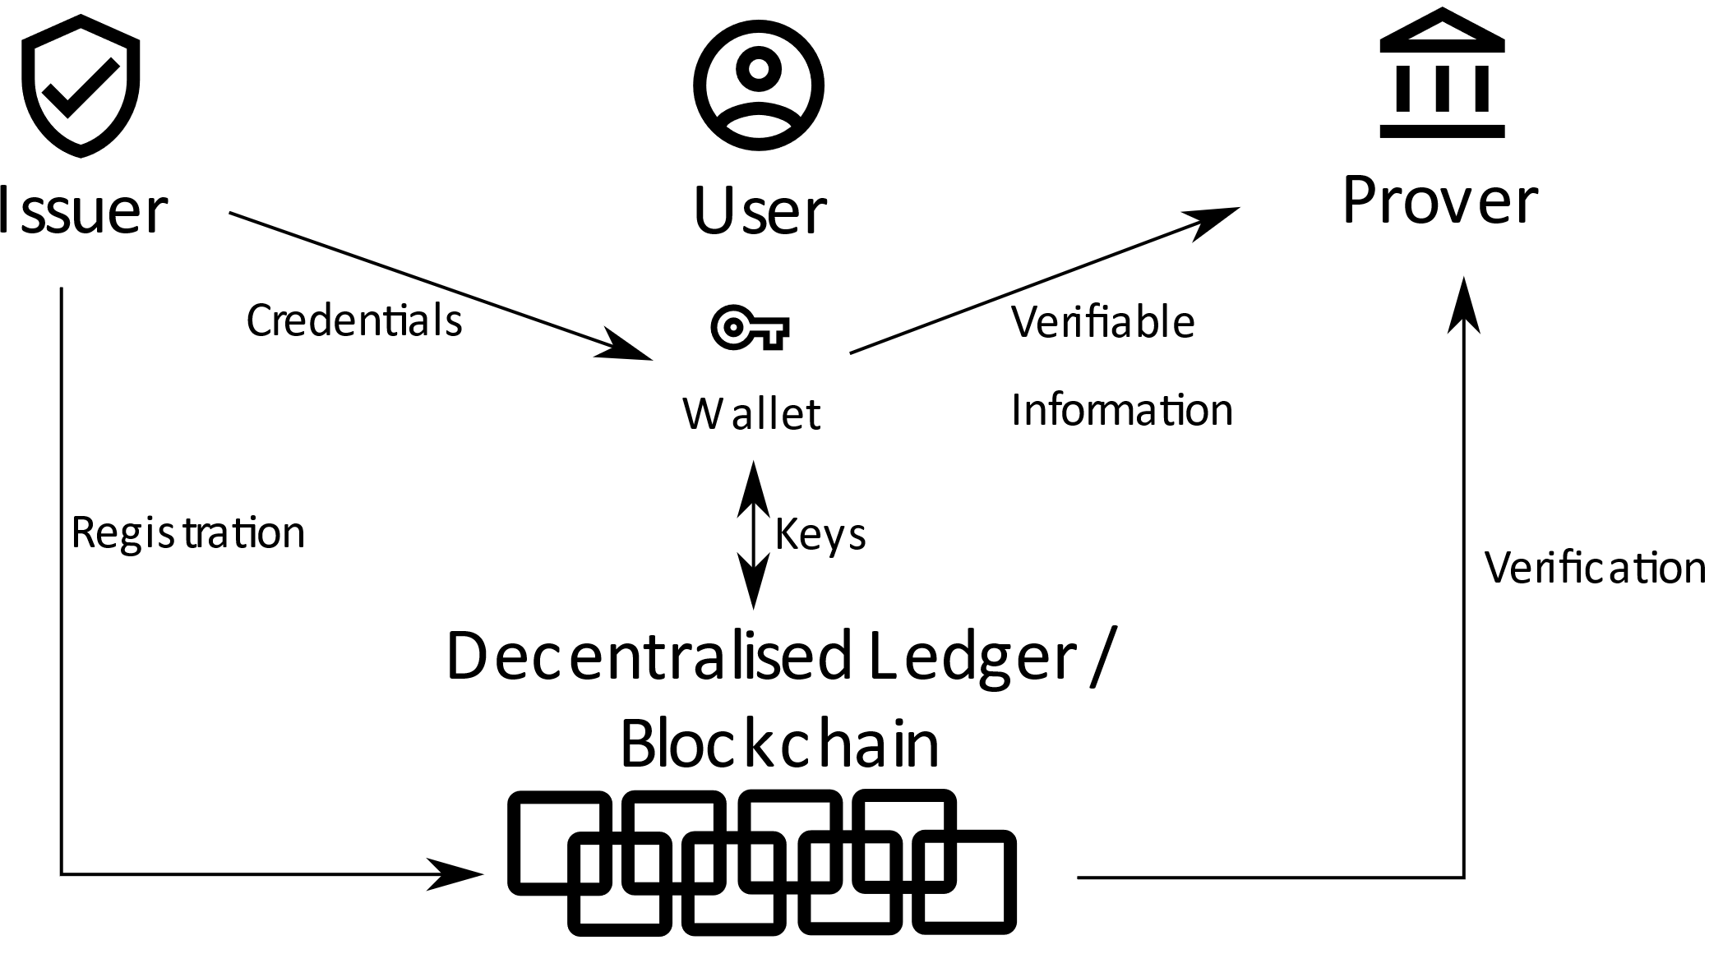
Self Sovereign Identity

Slide 4
Enhancing Privacy And Control
Mix and Match credentials from different sources
Transform credentials to only provide the minimum amount
Track, log and accept/reject each data request
Data ownership – The user owns their own data!

Slide 5
Research Document Preview

Slide 6
Thank you

